Slide 1


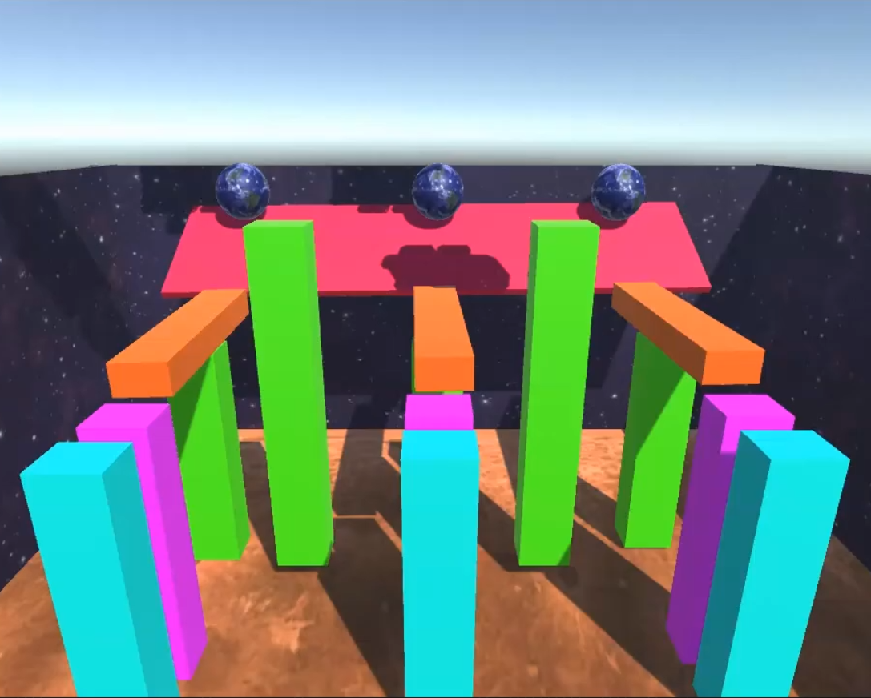




Code U: Level 1
Code U: Level 1
Game Design and App Development
AP Computer Science Principles
MAKE 3D GAMES
DESIGN WEBSITES
CREATE YOUR OWN APPS
NO PREREQUISITES
2.0 HIGH SCHOOL CREDITS
EARN UP TO 5 AP CREDITS
EARN UP TO 6 INDUSTRY CREDENTIALS

Slide 2
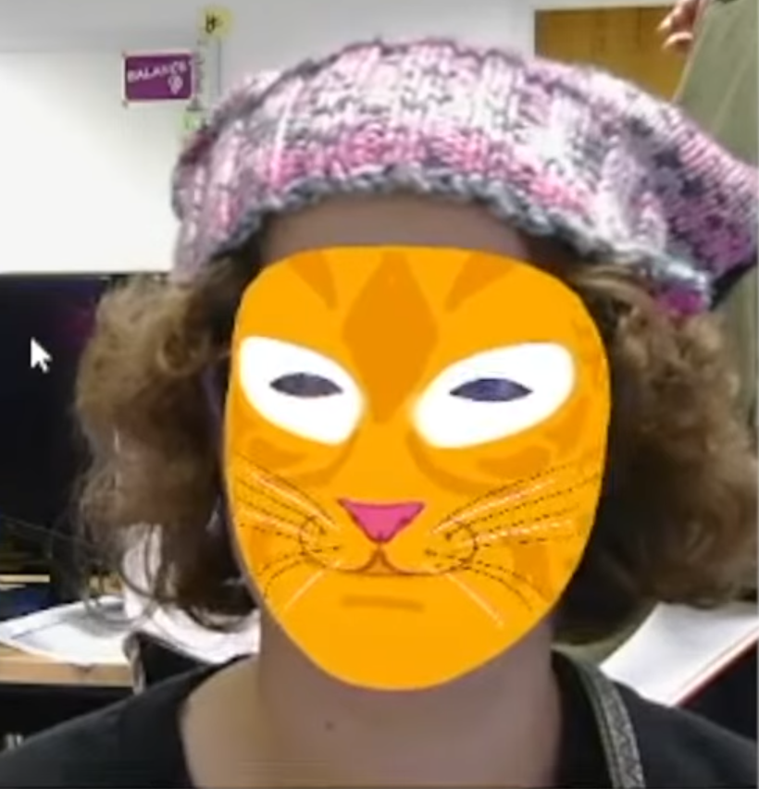
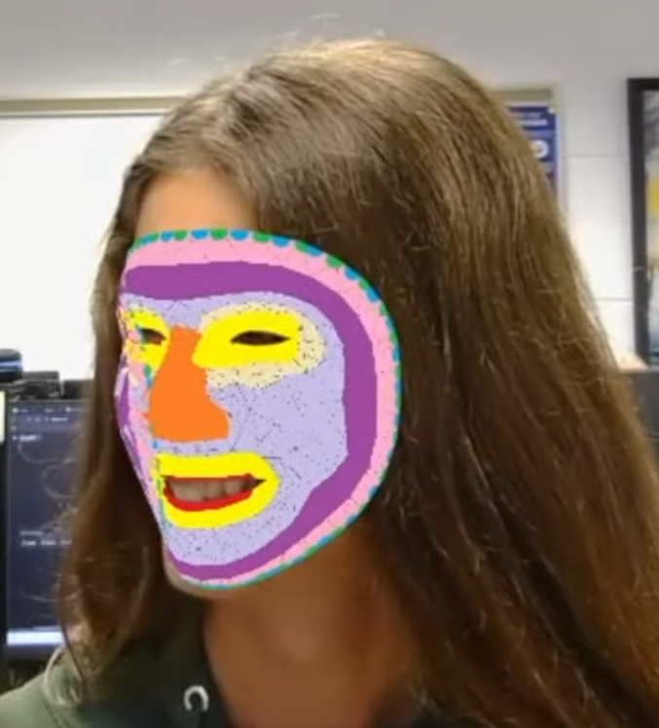


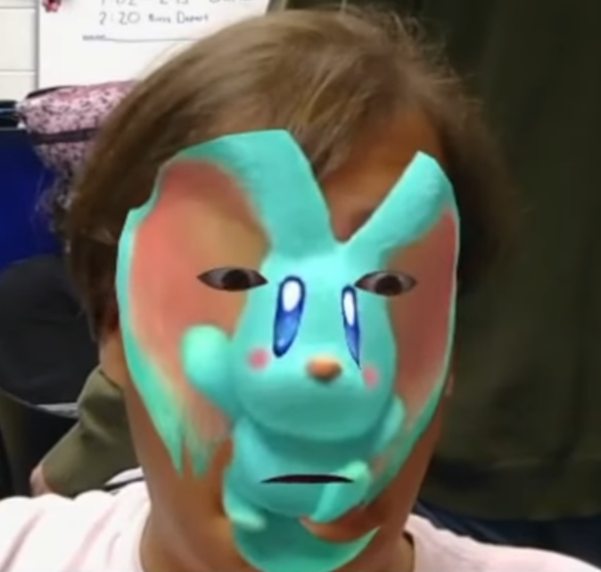
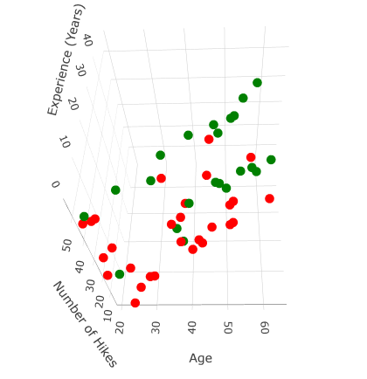


Code U: Level 2
Code U: Level 1
A.I. and Cloud Computing
AP Computer Science A
CODE MINECRAFT MODS
CONSTRUCT SIMULATIONS
BUILD YOUR OWN A.I.
PREREQUISITES: Level 1 or APCSP
2.0 HIGH SCHOOL CREDITS
EARN UP TO 5 AP CREDITS
EARN UP TO 6 INDUSTRY CREDENTIALS

Slide 3




Tolles ELITE Internship
Code U: Level 1
Year 3 of Code U
STEM Internships
LEARN PROFESSIONAL SKILLS
COLLABORATE ONLINE
EARN INDUSTRY CREDENTIALS
PREREQUISITES: Level 2 or APCSA
0.5 HIGH SCHOOL CREDITS PER SEMESTER
EARN UP TO 6 INDUSTRY CREDENTIALS

